Slide 1

Stock Market Analysis
Using NLP and Machine Learning for Enhanced Forecasting.
by Shovan Bera

Slide 2
Project Overview
This project predicts stock market movements. We combine Twitter dataset with stock price data. We analyze tweets sentiment score using NLP techniques. Sentiment is categorized as positive, negative, or neutral. Then we correlate sentiment with price changes. This helps identify trends for stock price predictions.
Stock Data
Twitter Data
Daily closing and adjusted prices.
Thousands of stock-related tweets.

Slide 3



Problem Statement & Objectives
Unstructured Tweets
Raw tweets are noisy and hard to read.
Extract Sentiment
Meaningful trends are difficult to find.
Our objectives are to clean tweet data. We extract sentiments using NLP. Finally, we correlate sentiment with stock prices.

Slide 4
Dataset Description
Stocks Dataset
Tweets Dataset
This dataset has 5 columns: Positive, Negative, Neutral, adj_price, close_price. It contains 600 rows of data.
This dataset has 4 columns: Date, closing_price, adj_close_price, Tweets. It contains 3653 rows of data.

Slide 5
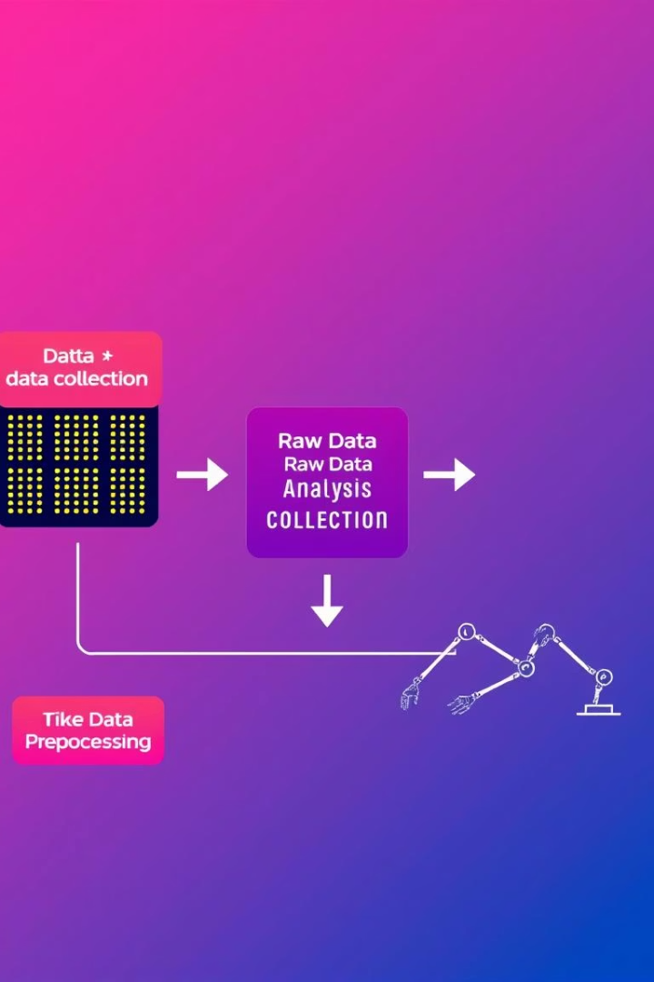
Methodology
1
Data Collection
Gathering stock and tweet data.
2
Data Preprocessing
Cleaning irregular tweet formatting.
3
Tweet Structuring
Using Python and Pandas for cleaning.
The Stocks Dataset includes sentiment values and pricing data. The Tweets Dataset contains raw tweet text and associated stock prices. Tweets often contain line breaks. We structured each tweet into a single, consistent row.

Slide 6
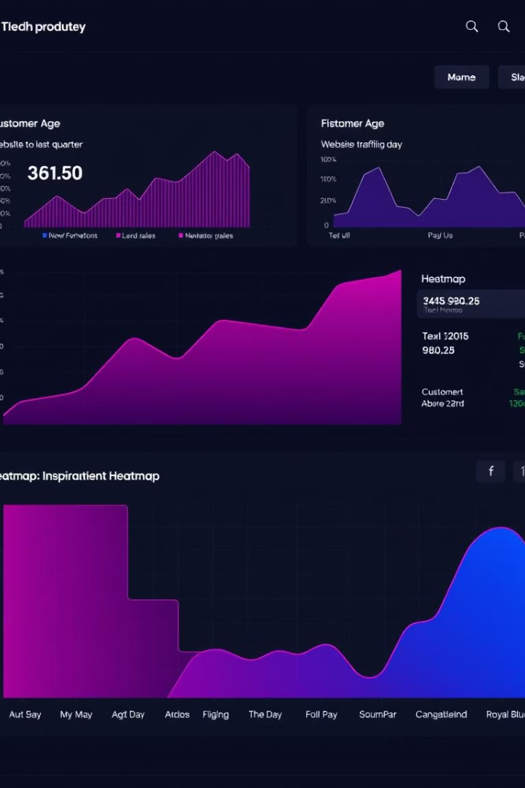
Exploratory Data Analysis (EDA)
Stocks Data Analysis
Tweets Data Analysis
Sentiment histograms (Positive, Negative, Neutral).
Closing price over time.
Line plots of adj_price vs close_price.
Line plots of adj_price vs close_price.
Tweet length distribution.
Correlation heatmaps.
Correlation heatmaps.
Merged Data Analysis
Sentiment histograms (Positive, Negative, Neutral).
Closing price over time, line plots, tweet length, and correlation heatmaps.

Slide 7
Technology & NLP
Programming Language: Python
Libraries: Pandas, NumPy, NLTK, VADER
Text Cleaning
Preparation of raw text.
Tokenization
Breaking text into words.
Stemming & Lemmatization
Reducing words to base forms.
TF-IDF Vectorization
Converting text to numbers.
Sentiment Analysis
Using VADER for scoring.

Slide 8




Natural Language Processing (NLP)
Text Preprocessing
Feature Extraction
Sentiment Analysis
Removed URLs, mentions, hashtags, punctuation, and stop words. Tweets split into individual words. Words reduced to root or dictionary forms. Cleaned tweets converted to a list.
TF-IDF Vectorization converted text to numeric features.
VADER applied for sentiment scores. Sentiment categorized as Positive, Neutral, or Negative.

Slide 9
NLP Visualization
Sentiment Score
Closing Price
The chart displays tweet sentiment scores and closing prices over time. This visual analysis helps in understanding the correlation between public mood and market trends. We can observe how sentiment fluctuations align with changes in stock values.

Slide 10



Conclusion
Key Points
Public sentiment impacts stock prices. NLP effectively analyzes tweet data.
Future Work
Explore advanced NLP techniques. Implement real-time sentiment monitoring.
Our project successfully demonstrated the link between sentiment and stock market behavior. Future enhancements will improve prediction accuracy.

